Slide 1
The Rady School of Management
Lecture #9
MGT103 Winter 2020
Marketing Segmentation
Targeting, Positioning
Wednesday, February 5
M,W 11:00a.m – 12:20 p.m.

Slide 2
Best of the Super Bowl Ads!
https://www.youtube.com/watch?v=n9weiTXQjns
https://www.youtube.com/watch?v=8y-1h_C8ad8
What is the key message of the ad?
Who is the target demographic?
What techniques/strategies make it memorable?

Slide 3
LEARNING OBJECTIVES
Explain what market segmentation is and when to use it.
Identify the five steps involved in segmenting and targeting markets.
Recognize the bases used to segment consumer and organizational (business) markets.

Slide 4
LEARNING OBJECTIVES
Develop a market-product grid to identify a target market and recommend resulting marketing actions.
Explain how marketing managers position products in the marketplace.

Slide 5
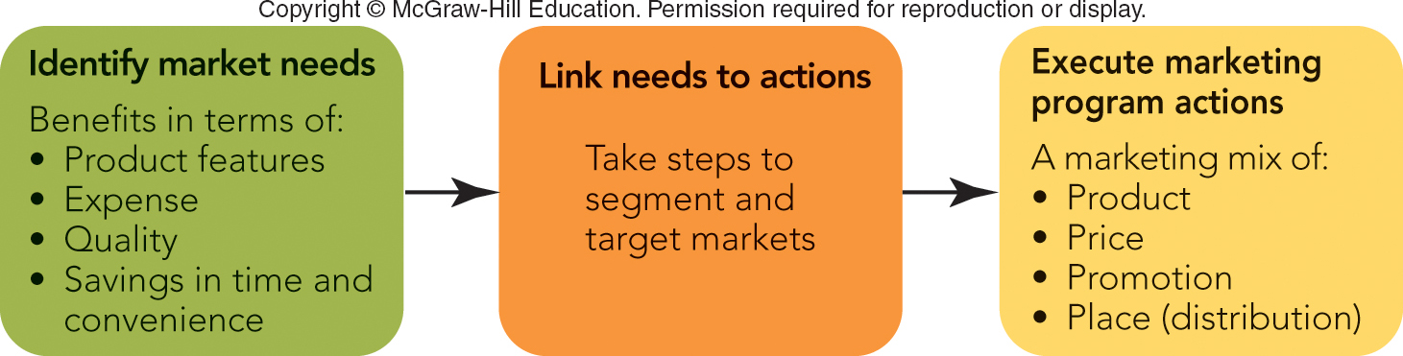
FIGURE 9-1 Market segmentation links market needs to an organization’s marketing program through marketing mix actions.
Jump to Appendix 1 long image description

Slide 6
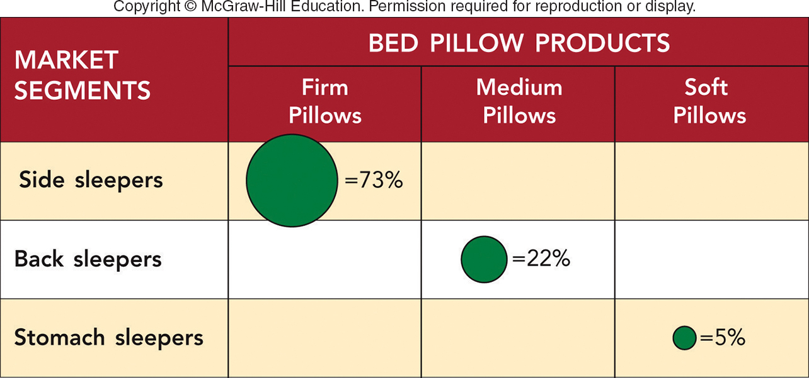
FIGURE 9-2 A market-product grid shows the kind of sleeper that is targeted for each of the bed pillows with a different firmness.
Using Market-Product Grids
Jump to Appendix 2 long image description

Slide 7
WHY SEGMENT MARKETS? WHEN AND HOW TO SEGMENT MARKETS (1 of 2)
One-Size-Fits-All Mass Markets No Longer Exist
Three Segmentation Strategies:
One Product and Multiple Market Segments (Example: Books)
Multiple Products and Multiple Market Segments (Example: Cars)
Segments of One–“Mass Customization” (Example: Tailor Products to Individuals)

Slide 8
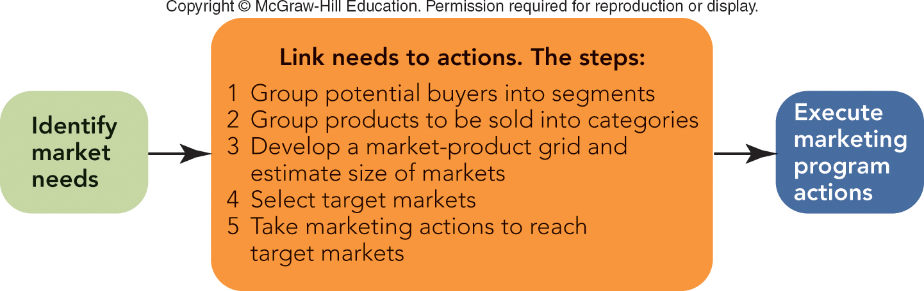
FIGURE 9-3 The five key steps in segmenting and targeting markets that link market needs to a firm's marketing program.
research
Jump to Appendix 4 long image description

Slide 9
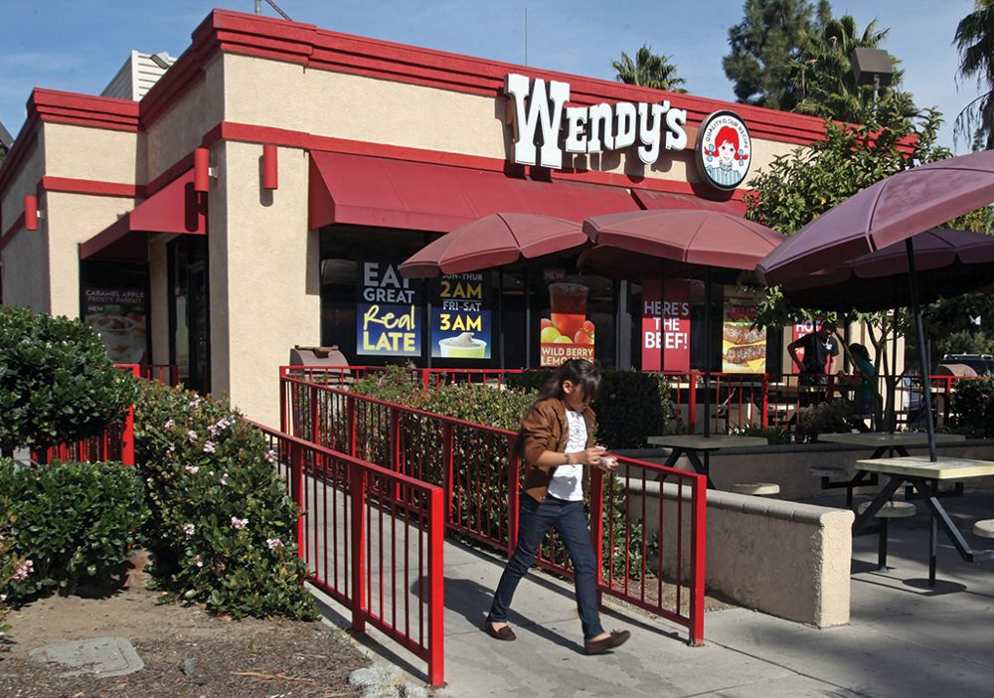
SEGMENTING AND TARGETING MARKETS STEP 1: GROUP POTENTIAL BUYERS INTO SEGMENTS (1 of 4)
Criteria to Use in Forming the Segments
Simplicity and Cost-Effectiveness
Potential for Increased Profit
Similarity of Needs of Buyers in Segment
Difference of Needs of Buyers among Segments
Potential of Marketing Action to Reach Segment
©Reed Saxon/AP Images

Slide 10
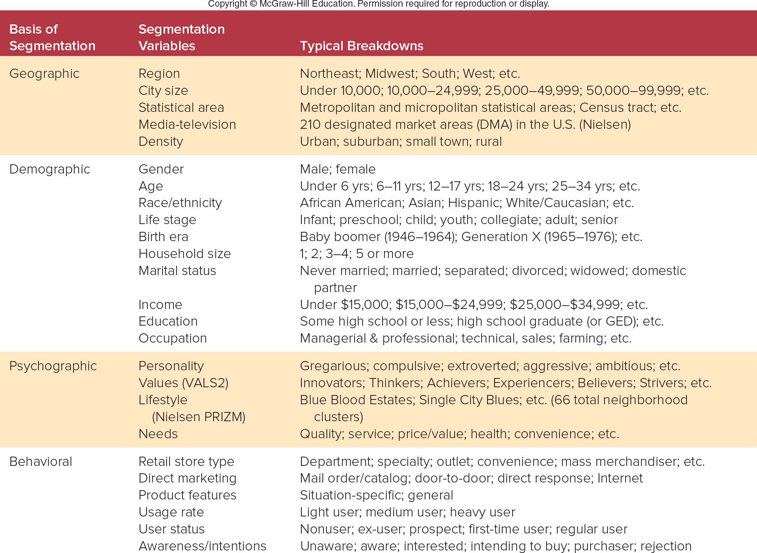
FIGURE 9-4 Segmentation bases, variables, and breakdowns for U.S. consumer markets

Slide 11
SEGMENTING AND TARGETING MARKETS STEP 1: GROUP POTENTIAL BUYERS INTO SEGMENTS (3 of 4)
Variables to Use in Forming Segments for Wendy’s:
Students:
Dorms, Sororities, and Fraternities
Apartments
Day Commuters
Night Commuters
Nonstudents:
Faculty and Staff
Residents in Area
Workers in Area

Slide 12
SEGMENTING AND TARGETING MARKETS STEP 2: GROUP PRODUCTS INTO CATEGORIES
Individual Wendy’s Products
Groupings of Wendy’s Products: Meals
Breakfast
Lunch
Between Meal Snack
Dinner
After Dinner Snack

Slide 13
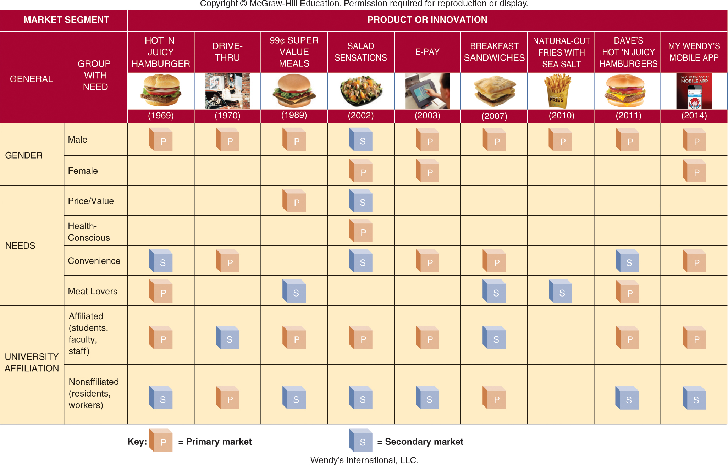
FIGURE 9-8 Wendy’s new products and innovations target specific market segments based on a customer’s gender, needs, or university affiliation.

Slide 14
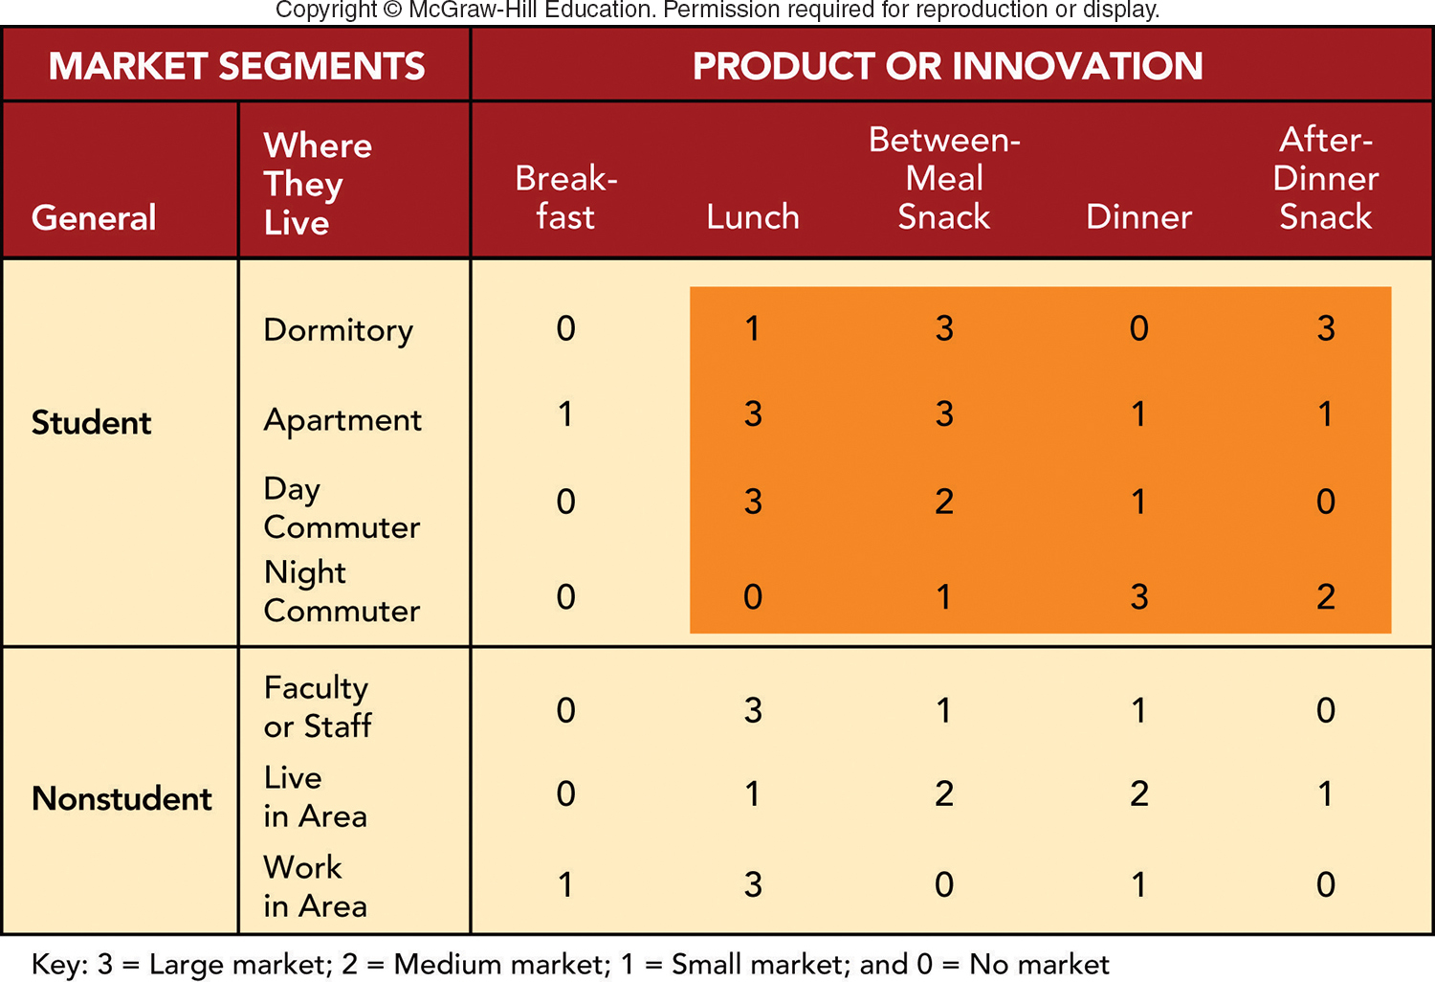
FIGURE 9-9 Selecting a target market for your Wendy’s fast-food restaurant next to an urban university (target market is shaded).

Slide 15
SEGMENTING AND TARGETING MARKETS STEP 4: SELECT TARGET MARKETS (1 of 3)
Criteria to Use in Selecting Target Markets
Two Types of Criteria:
Those That Divide a Market into Segments
Those That Actually Pick the Target Segments

Slide 16
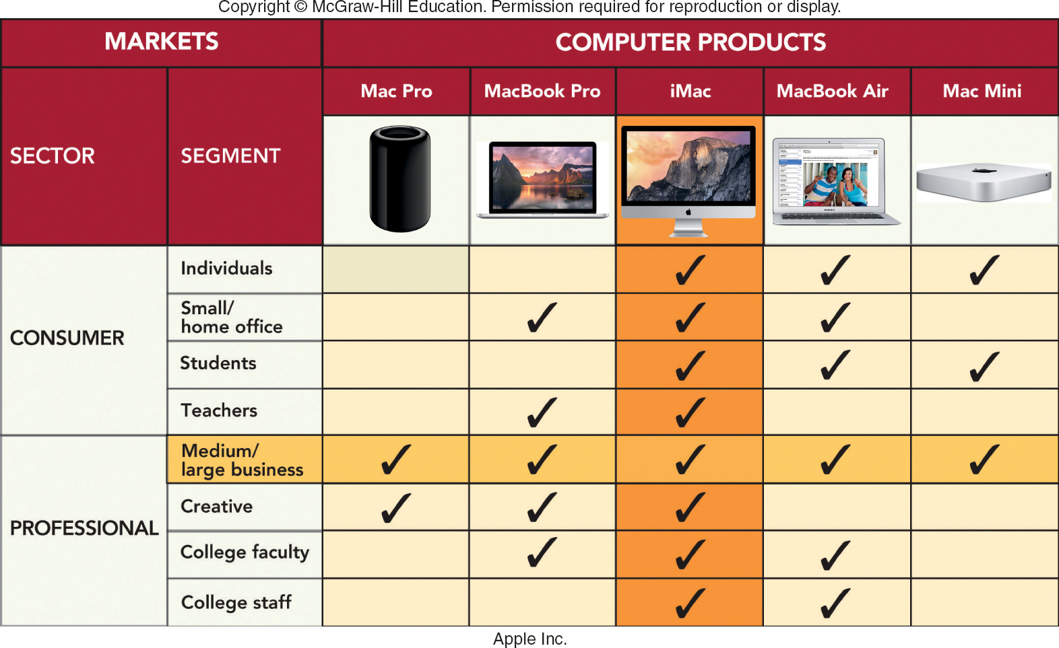
MARKETING MATTERS Apple’s Segmentation Strategy
Jump to Appendix 8 long image description

Slide 17
POSITIONING THE PRODUCT (1 of 2)
Product Positioning
Product Repositioning
Two Approaches to Product Positioning
Head-to-Head Positioning
Differentiation Positioning
Writing a Positioning Statement

Slide 18
POSITIONING THE PRODUCT (2 of 2)
Product Positioning Using Perceptual Maps:
Identify Important Attributes for a Product or Brand Class
Discover how Customers Rate Competing Products or Brands on These Attributes
Discover Where the Company’s Product or Brand Is on these Attributes in Minds of Customer.
Reposition the Company’s Products or Brands in the Minds of Consumers

Slide 19
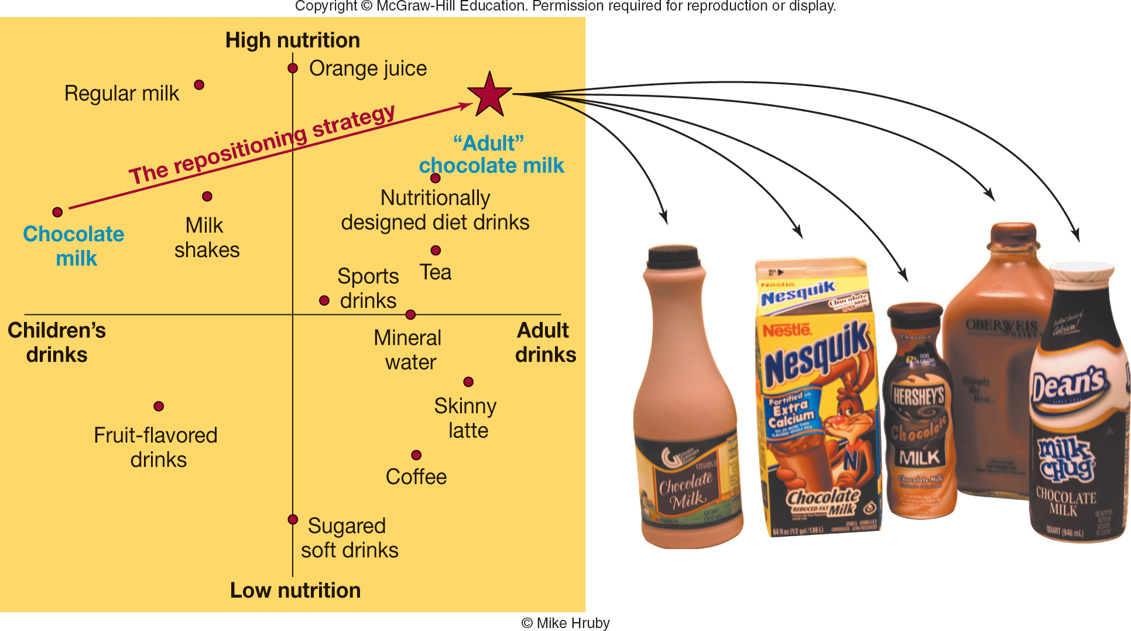
FIGURE 9-11 The strategy American dairies are using to reposition chocolate milk to reach adults.
Jump to Appendix 9 long image description

Slide 20
Group Assignments – Team Project
Each of you have been assigned to a Working Group (#1 - #8)
Assignment is to create a Marketing Plan for a new product or service. You decide!
Follow the template for “Marketing Plan” in Appendix 2 of the textbook (page #56). Read this carefully!
Each of you to take on a Specific Section of the Plan (i.e. Executive Summary, Company Description, Strategic Focus and Plan, etc.)

Slide 21
Group Assignments
Group Leader to be chosen (2% extra credit points towards final grade; 20 points)
Group Leader finalizes PowerPoint & Executive Summary “2 pager”. This will serve as his/her
Executive Summary Brief
Remaining Team Members pick one of the remaining 8 “elements of the plan”, page #57
Description of Company 6. Marketing Program
Strategic Plan/Focus 7. Financials, Org structure
Situation Analysis (SWOT) 8. Implementation Plan
Market-Product Focus 9. Evaluation Plan
Each team member will create 2-3 slides, and a 2-3 page Executive Summary Brief of their topic
Group of 10; 2 people with share the SWOT

Slide 22
Considerations…….
Pick a product, service, segment that you understand fairly well
This is a “start up” company. No one knows you!
Suggest weekly team meetings to review content. You have 5 weeks to complete the Power Point and Summary Brief. Both are due on March 11th
PowerPoint rules….6 X 6 “six lines, six words”
Select a template for your Brand…keep it simple!
A picture is worth a thousand words! Graphs, charts, pictures strongly encouraged!
Use the outlines in the textbook, they are very helpful

Slide 23
Considerations…….
Neatness counts! (No typos, blurry images)
Consistent use of color and fonts
Avoid effects unless deliberately used (don’t let Power Point be a distraction to your presentation)
You are asking a Venture Capitalist or CEO to approve your launch….it should look that way

Slide 24
Announcements……..
Read Chapter #10 – New Products & Services
Monday, February 10th- Mid-Term Review! Not to be missed
Chapters #1-#10, Case Studies #1,2 (GM: Mary Barra, Starbucks)
Mid-Term Examination on Wednesday, February 12th
Office Hours on Monday, 1:30 p.m. – 2:30 p.m. please use Canvas Calendar for appointment

Slide 25
The Rady School of Management
Lecture #9
MGT103 Winter 2020
Marketing Segmentation
Targeting, Positioning
Wednesday, February 5
M,W 11:00a.m – 12:20 p.m.

